Slide 1

Metro car Project

Slide 2
Agenda Slide
Introduction to Metro car business and the Funnel analysis.
Results and findings
Recommendations.
Conclusion.

Slide 3
Metro car Business
Metro car operates on a business model revolving around a platform connecting riders with drivers via a mobile application.
Stakeholders in the business have raised key business questions aimed at revealing valuable insights for enhancing specific aspects of the customer funnel.

Slide 4
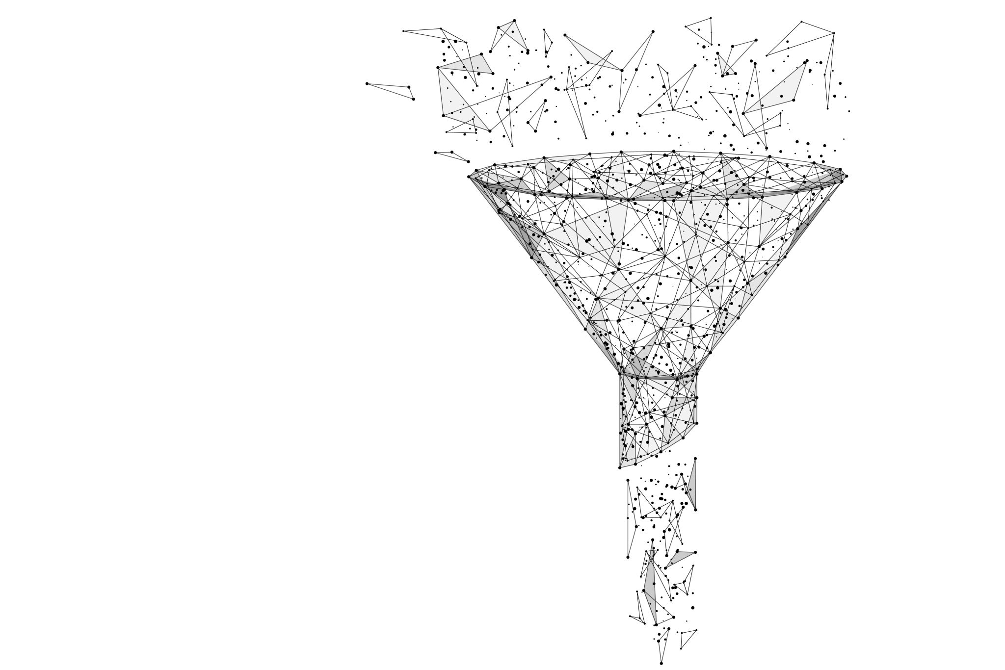
Funnel Analysis
Funnel analysis is a method of data analysis used to track and understand the sequential steps or stages that users or customers go through when interacting with a product, service, or website.

Slide 5
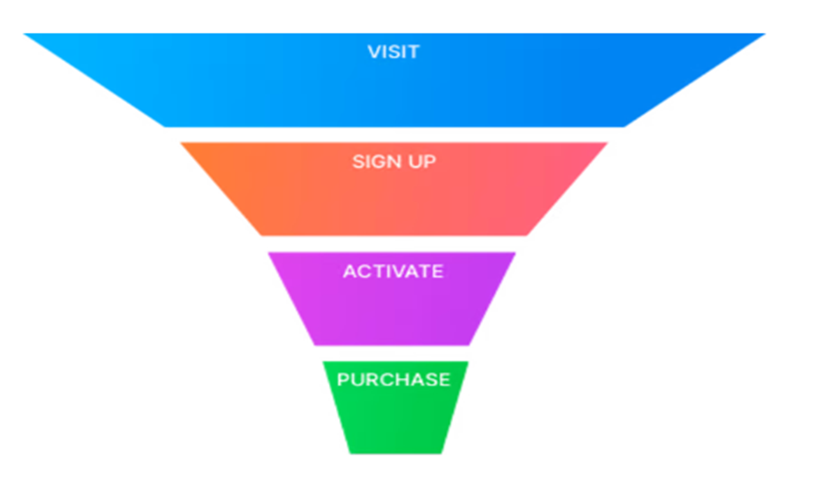
Funnel steps

Slide 6
Stages of the customer funnel requiring improvement
Drop in conversion from application download to sign-up, from 100% to 74.65%, suggests potential challenges in the user onboarding process.
Significant drop in the conversion rate from ride acceptance (98.97%) to ride completion (50.77%) indicates potential challenges in the execution and fulfilment stages of the customer funnel.
Drop in conversion from payments (100%) to reviews (69.76%) suggests challenges in encouraging users to provide feedback after completing a payment.

Slide 7
Application platform device
The chart below indicate that the platform had 237,871 ios users, followed by Android with 113,846, and web 38,977.
The analysis reveals a substantial preference for the ios phone, indicating a 60.88% higher usage compared to the Android phone with 29.14%, and web at 9.98%.

Slide 8
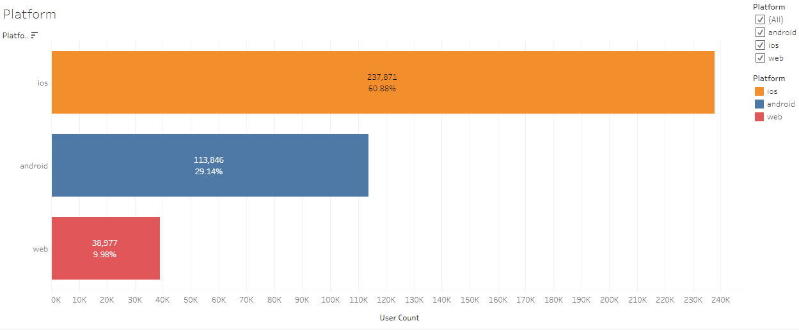
Platform device
ios phone boosted the highest platform users with 237,871 users at 60.88%.
Android phone with 113,846 at 29.14%.
Web users is 38,977 with 9.98%.

Slide 9
Age Group performance
Age group 35-44 demonstrated the highest frequency of app users totalling 115,728 constituting 29.62%, as indicated in the bar chart below.
The 'unknown' age group, constituting 30.02% with 117,299 users is classified under GDPR, and excluded from the analysis to avoid bias results
Age group 25-34 recorded 76,258 users with 19.52%.
Age group 18-24 had 41,185 users with 10.54%.
Age group 45-54 had 40,224 users with 10.30%

Slide 10
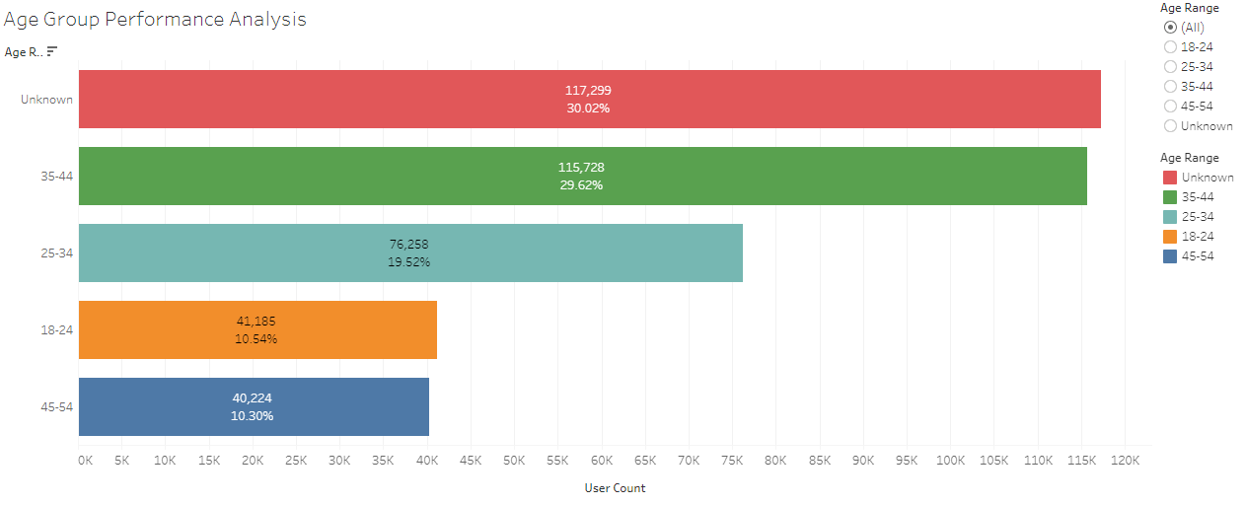
Age group performance
Age group 35-44 recorded the highest users totalling 115,728 constituting 29.62%.
Age group 25-34 had the second highest users totalling 76,258 constituting 19.52%.

Slide 11
Ride requests distribution outlook for the day
The line chart highlights two peak periods with the highest number of ride requests. One occurring at 4:21:00 p.m. with 115 users, and another at 9:07:46 a.m. with 111 total users.
These time points represent the instances of the day when ride requests reached their maximum, providing insights into the app's usage patterns throughout the day.

Slide 12
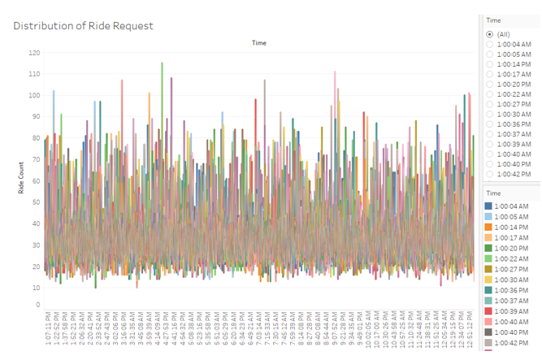
Ride requests distribution
Two peak periods with the highest number of ride requests occurred at 4:21 Pm and 9:07 Am.
A total of 115 users made request at 4:21 Pm and 111 users made request at 9:07 Am.

Slide 13
Lowest conversion rate in the funnel
The customer funnel analysis employs a percentage-based approach to highlight a critical insight in the conversion rate.
At the 'payment to review' stage, there is a notable 69.76% decrease in the conversion rate, signalling a significant decline in user engagement or completion of the conversion process, suggesting a potential area for improvement to enhance the overall conversion rates.

Slide 14
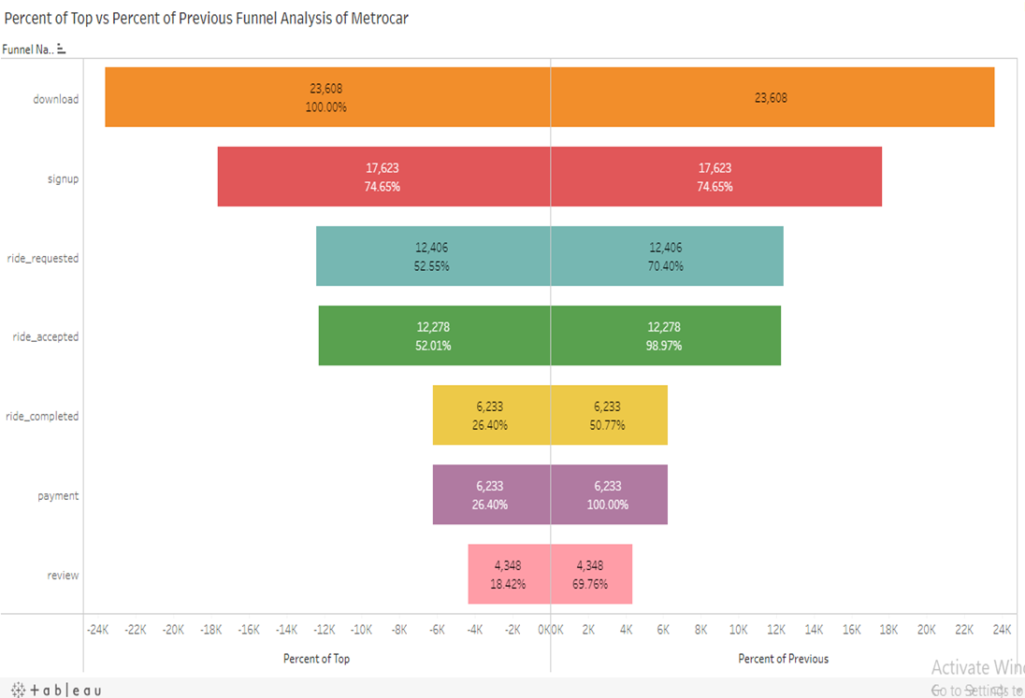
Metro car customer funnel analysis
The percentage-based analysis of the Metro car customer funnel indicates that the 'payment to review' stage has the lowest conversion rate, standing at 69.76%.

Slide 15
Recommendations
Given the dominance of iOS usage, stakeholders should prioritize further optimization of the app, introducing features that cater to iOS users' preferences and ensuring compatibility with the latest iOS updates.
Focus marketing efforts on the 35-44 age group, as they constitute the highest number of app users. Tailor promotions and campaigns to resonate with the preferences and needs of this age segment to further boost engagement.
Identify specific issues causing the significant drop in the conversion rate on each customer funnel stages specifically, from the payment to the review stage. Implement strategies to streamline this process, reduce friction, and encourage users to complete the entire customer funnel.
Since the ride requests peak at specific times (4:21:00 PM and 9:07:46 AM), stakeholders should ensure that the service is optimized during these hours to handle increased demand efficiently.

Slide 16
Limitations in the customer funnel of the project
In the age group analysis for assessing user performance of the Metro car app, a significant observation was noted. Approximately 30.02% of the data, encompassing 117,299 users lacked age information and was categorized as 'unknown' group under GDPR.
This group was intentionally excluded from the analysis to prevent potential distortions in the results.

Slide 17
Conclusion
Tailor development, budget, and marketing strategies to the clear preference for iOS, which has a significantly higher usage percentage compared to Android and the web.
The 35-44 age group segment is the most active user group; align marketing and service improvements with their preferences and needs to enhance user satisfaction and retention.
The observed drop in conversion from payment to the review stage is critical; resolving this bottleneck is essential for improving overall customer funnel efficiency and increasing user retention.
Recognize peak times for ride requests and ensure the service can handle increased demand during these periods; optimization may involve resource allocation, system efficiency improvements, and enhancing user experience during high-traffic hours.

Slide 18
Video presentation link
https://www.loom.com/share/72a503b8ac884455830c29d00f6d5a85

Slide 19
Thank you for Listening
Ejikeme Justine Ekwem
Master school

